Slide 1
Citing genAI
Best Practices in PowerPoint

Slide 2
Words Shakespeare Coined
Swagger
  Originally used in A Midsummer Night’s Dream, this word now describes a confident and stylish manner.
Bedazzled
  From The Taming of the Shrew, it means to be dazzled or impressed, often by something shiny or impressive.
Lonely
  First appearing in Coriolanus, this word describes the feeling of being alone or isolated.
Gossip
  Used in The Comedy of Errors, it originally referred to a godparent but now means casual or idle talk about others (Microsoft, 2024; see Appendix A).

Slide 3
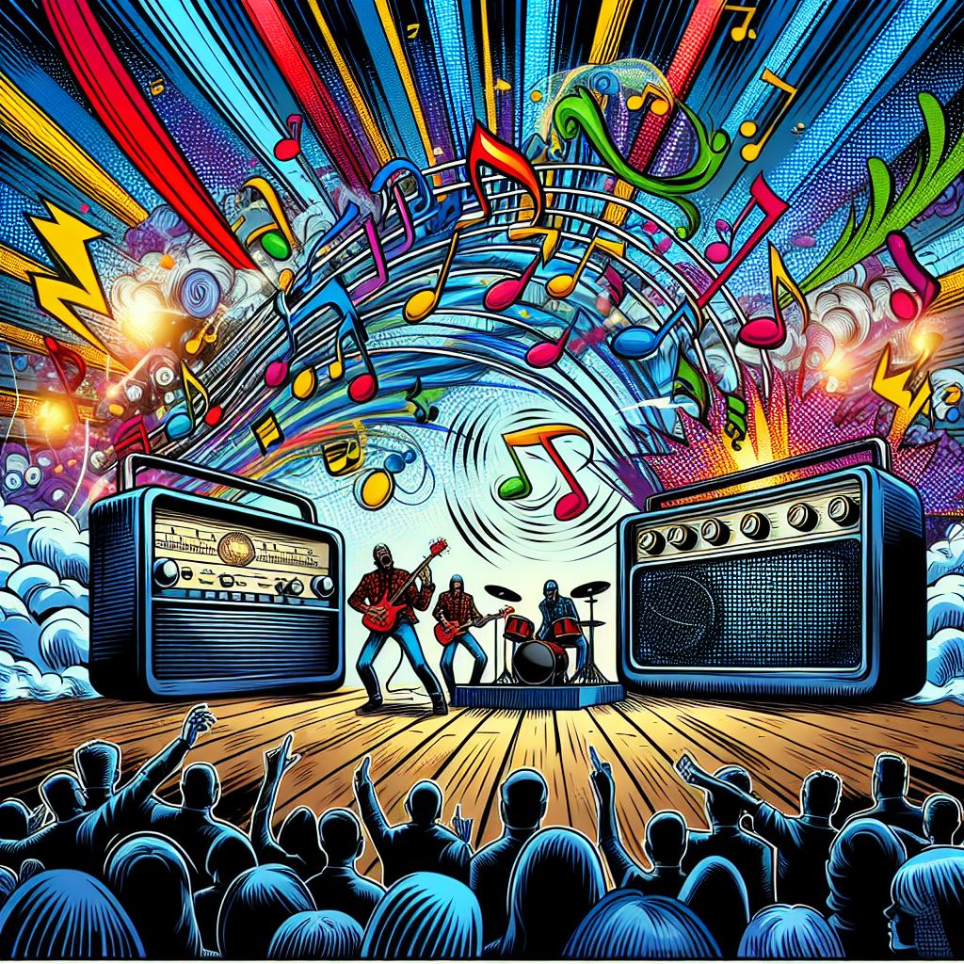
Radio and Popular Musical
Image: Microsoft (2024; see Appendix B)

Slide 4
References
  Microsoft. (2024). Copilot [Large language model]. https://m365.cloud.microsoft/chat/

Slide 5
Appendix A
User:
Write the text content for a single slide of a slideshow. The slideshow's title is Why is Shakespeare still important today. The slide that you are to create should be on the topic of words that Shakespeare coined that are in current use. There should only be four examples given.
Copilot:
### Words Shakespeare Coined That Are Still in Use Today
**1. **Swagger**
- Originally used in "A Midsummer Night's Dream," this word now describes a confident and stylish manner.
**2. **Bedazzled**
- From "The Taming of the Shrew," it means to be dazzled or impressed, often by something shiny or impressive.
**3. **Lonely**
- First appearing in "Coriolanus," this word describes the feeling of being alone or isolated.
**4. **Gossip**
- Used in "The Comedy of Errors," it originally referred to a godparent but now means casual or idle talk about others.
These examples highlight Shakespeare's lasting impact on the English language, showing how his creativity continues to influence our daily communication.

Slide 6
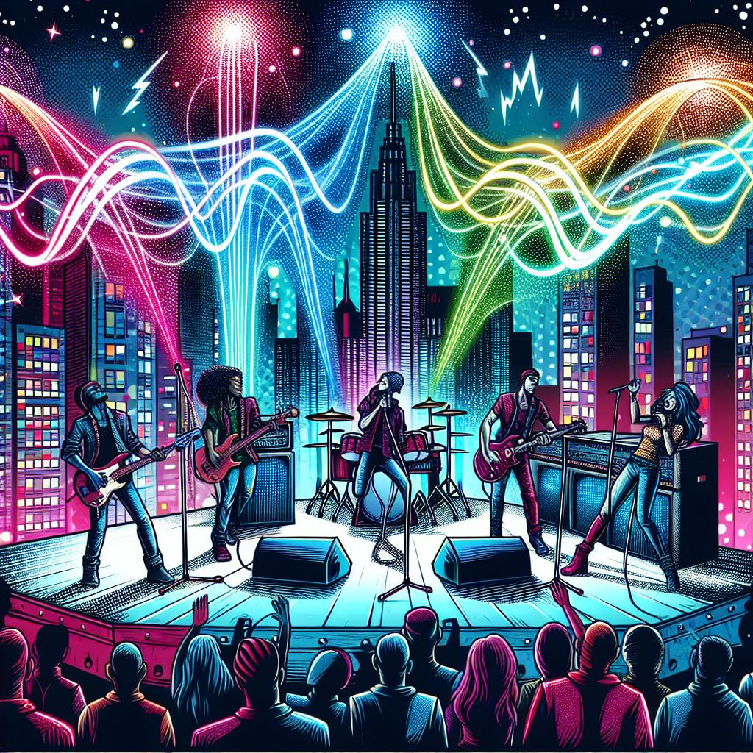
Appendix B
User: Create an image that metaphorically depicts a rock band's music being played over the radio airwaves. The style of the image should be like a comic book.
Copilot: I’ll try to create that.

